Slide 1

PROJECT
KEYLOGGER & SECURITY
VADLAMUDI VIGNAPAN KUMAR

Slide 2

KEYLOGGER & SECURITY
A keystroke logger, commonly referred to as a keylogger, is a form of surveillance technology designed to monitor and record every keystroke made on a keyboard. These loggers can manifest as either software or hardware. Software keyloggers are typically installed clandestinely on a computer or mobile device, capable of capturing a vast array of data, including passwords, messages, and other personal information. On the other hand, hardware keyloggers are physical devices connected to a computer, usually placed between the keyboard and the computer, to intercept and record keystrokes. While keyloggers can serve legitimate purposes such as monitoring employee activity or recovering lost data, they are more commonly associated with malicious intentions, such as stealing sensitive information and committing identity theft. It's crucial for users to remain vigilant and employ security measures to protect against unauthorized access and data breaches facilitated by keyloggers.

Slide 3

Understanding keyloggers and bolstering security measures against them is paramount, given the substantial risk they pose to personal and organizational data security. Keyloggers, whether deployed through software or hardware, have the capability to surreptitiously capture sensitive information like passwords, financial details, and private communications, resulting in dire consequences such as identity theft, financial loss, and corporate espionage. Employing effective security measures, such as robust antivirus software, routine system monitoring, and practicing safe browsing habits, plays a critical role in detecting and thwarting keylogger infections.

Slide 4

AGENDA
Introduction to Keyloggers
Problem statement
Project overview
Who are the end users?
Solution and its value proposition
The wow in your solution
Detection of Keyloggers
Prevention and Protection Strategies
Modelling
Results

Slide 5
PROBLEM STATEMENT
The rising ubiquity of keyloggers presents a substantial challenge to digital security, jeopardizing the confidentiality and integrity of sensitive information. Despite strides in cybersecurity, numerous individuals and organizations persist in their susceptibility to these clandestine tools, capable of logging keystrokes to pilfer passwords, financial details, and confidential data.
This initiative aims to tackle the urgent demand for efficient detection and prevention methods against keyloggers. It will delve into the contemporary realm of keylogger technology, assess the efficacy of current security measures, and devise pioneering solutions to bolster defense against these dangers. Through these efforts, the project endeavors to alleviate the hazards linked with keyloggers, fortify the security of personal and organizational data, and foster a resilient digital environment.

Slide 6
PROJECT_OVERVIEW
Keyloggers:
Keyloggers are software or hardware tools designed to capture and record keystrokes made on a keyboard.
They can be used for legitimate purposes such as monitoring employee activity or recovering lost data, but are often associated with malicious activities.
Software keyloggers are installed covertly on a computer or mobile device and can capture a wide range of information including passwords, messages, and other personal data.
Hardware keyloggers are physical devices connected to a computer that intercept and record keystrokes as they are typed.
Security Measures:
Security measures are protocols and tools implemented to protect against threats such as keyloggers and other forms of cyberattacks.
Antivirus and anti-malware software can detect and remove keyloggers and other malicious software from a system.
Regular system monitoring and audits help to identify any unauthorized access or suspicious activity.
Strong and unique passwords, along with multi-factor authentication, can prevent unauthorized access even if a keylogger captures login credentials.

Slide 7
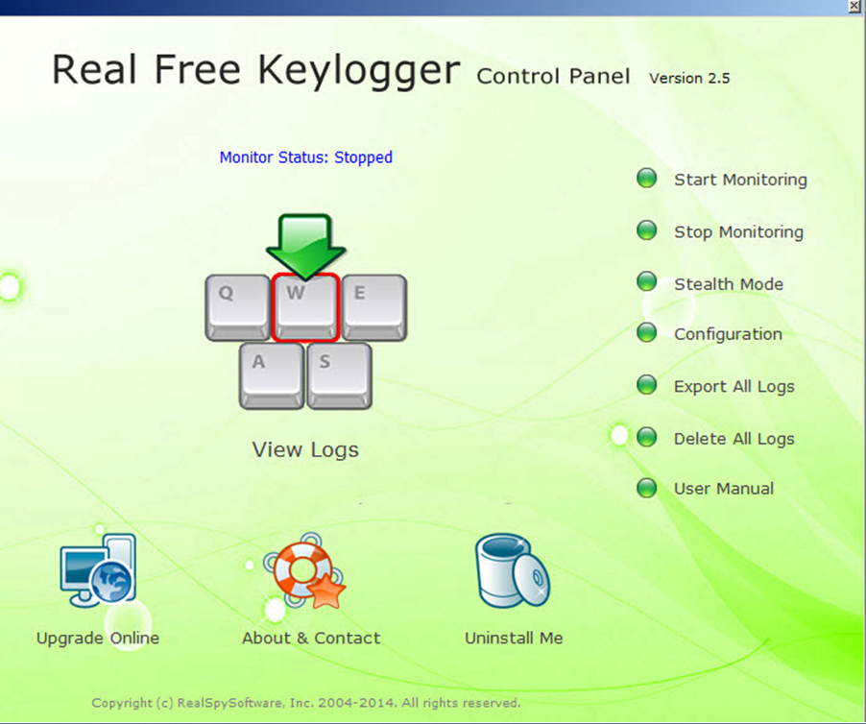

ADVANTAGES_OF_KEYLOGGERS
Monitoring and Surveillance: Keyloggers can be used for legitimate monitoring purposes, such as parental control to ensure children's online safety or employee monitoring to track productivity and adherence to company policies.
Data Recovery: In situations where data is accidentally lost, keyloggers can sometimes help recover the lost information by capturing keystrokes before they are deleted.
Investigative Tool: Law enforcement agencies and legal professionals can use keyloggers as part of their investigative toolkit to gather evidence in criminal cases or track suspicious activities.
System Diagnostics: Keyloggers can assist IT professionals in diagnosing technical issues and troubleshooting problems by providing a detailed log of user interactions.

Slide 8
DISADVANTAGES_OF_KEYLOGGERS
Privacy Invasion: Keyloggers have the potential to infringe on individuals' privacy by capturing sensitive information, such as passwords, personal messages, and browsing history, without their consent or knowledge.
Misuse and Abuse: Keyloggers can be misused for malicious purposes, such as stealing passwords, financial information, or intellectual property, leading to identity theft, financial fraud, or corporate espionage.
Legal and Ethical Concerns: The use of keyloggers without proper authorization or consent may violate privacy laws and ethical principles, resulting in legal repercussions and damage to reputation if discovered.
Security Vulnerabilities: Keyloggers themselves can become targets for exploitation by cybercriminals, leading to security vulnerabilities and potential breaches if not properly secured or maintained.
Cost and Complexity: Implementing comprehensive security measures can be costly and complex, requiring investment in software, hardware, personnel training, and ongoing maintenance.

Slide 9
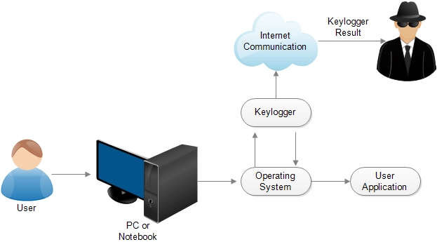
WHO_ARE_THE_END_USERS?
Ethical Hackers and Security Professionals:
Ethical hackers and security professionals may use keyloggers as part of penetration testing or security assessments to identify vulnerabilities in systems and applications. This helps organizations improve their security posture by addressing potential weaknesses before they can be exploited by malicious actors.
IT Administrators:
IT administrators may utilize keyloggers to troubleshoot technical issues, diagnose problems, or monitor system usage within their organization's network.
Cybercriminals:
Unfortunately, cybercriminals may also be end users of keyloggers, employing them for malicious purposes such as stealing sensitive information like passwords, financial details, or personal data. This stolen information can be used for identity theft, financial fraud, or other illicit activities.

Slide 10
SOLUTION_AND ITS_VALUE_PROPOSITION
Anti-Key-logger – As the name suggest these are the software which are anti / against key loggers and main task is to detect key-logger from a computer system.
Anti-Virus – Many anti-virus software also detect key loggers and delete them from the computer system. These are software anti-software so these can not get rid from the hardware key-loggers.
Automatic form filler – This technique can be used by the user to not fill forms on regular bases instead use automatic form filler which will give a shield against key-loggers as keys will not be pressed .
One-Time-Passwords – Using OTP’s as password may be safe as every time we login we have to use a new password.
Patterns or mouse-recognition – On android devices used pattern as a password of applications and on PC use mouse recognition, mouse program uses mouse gestures instead of stylus.
Voice to Text Converter – This software helps to prevent Keylogging which targets a specific part of our keyboard.

Slide 11

MODELLING
Import Required Modules:
Use Python's keyboard module to capture keystrokes.
Optionally, use other modules for logging, encryption, or network communication.
Set Up Logging:
Configure logging settings to specify the format and destination of log files.
Define Keylogger Function:
Create a function to capture and log keystrokes.
Use the keyboard.on_press() method to register a callback function to capture each key press event.
Main Function:
Create a main function to start the keylogger and keep it running indefinitely.
Testing and Deployment:
Test the keylogger program to ensure it captures keystrokes correctly.
Deploy the keylogger on target systems if necessary, ensuring compliance with legal and ethical considerations.
11

Slide 12

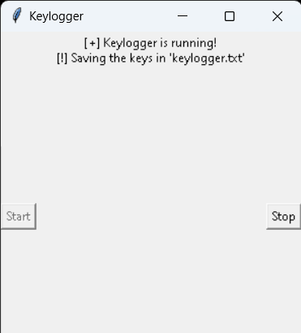
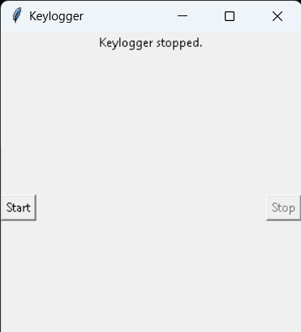
RESULT
The result of a keylogger program typically involves capturing and logging keystrokes entered by a user on a keyboard. These logged keystrokes can then be used for various purposes, depending on the intent of the keylogger user. The covert nature of keyloggers allows them to capture sensitive information, including passwords, personal messages, and financial details, without the user's knowledge or consent. This poses serious risks to individuals, organizations, and society at large, including identity theft, financial fraud, and unauthorized access to confidential data.
12

Slide 13

OUTPUT

